Slide 1
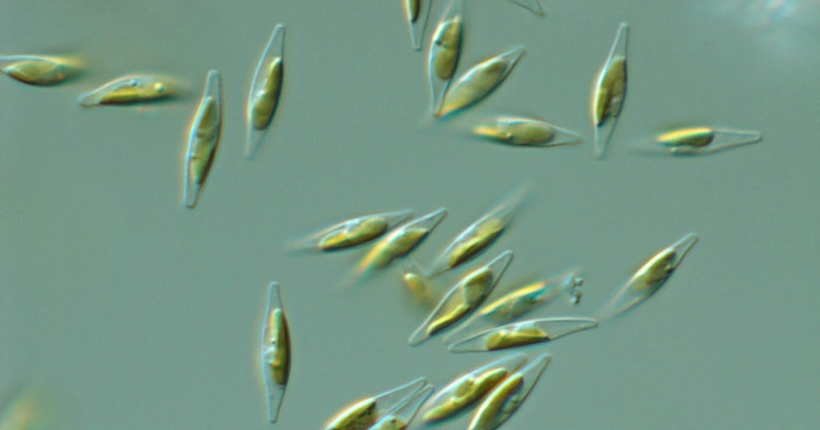
Orthogonal protein production from algae
March 11, 2022 for Suncor

Slide 2
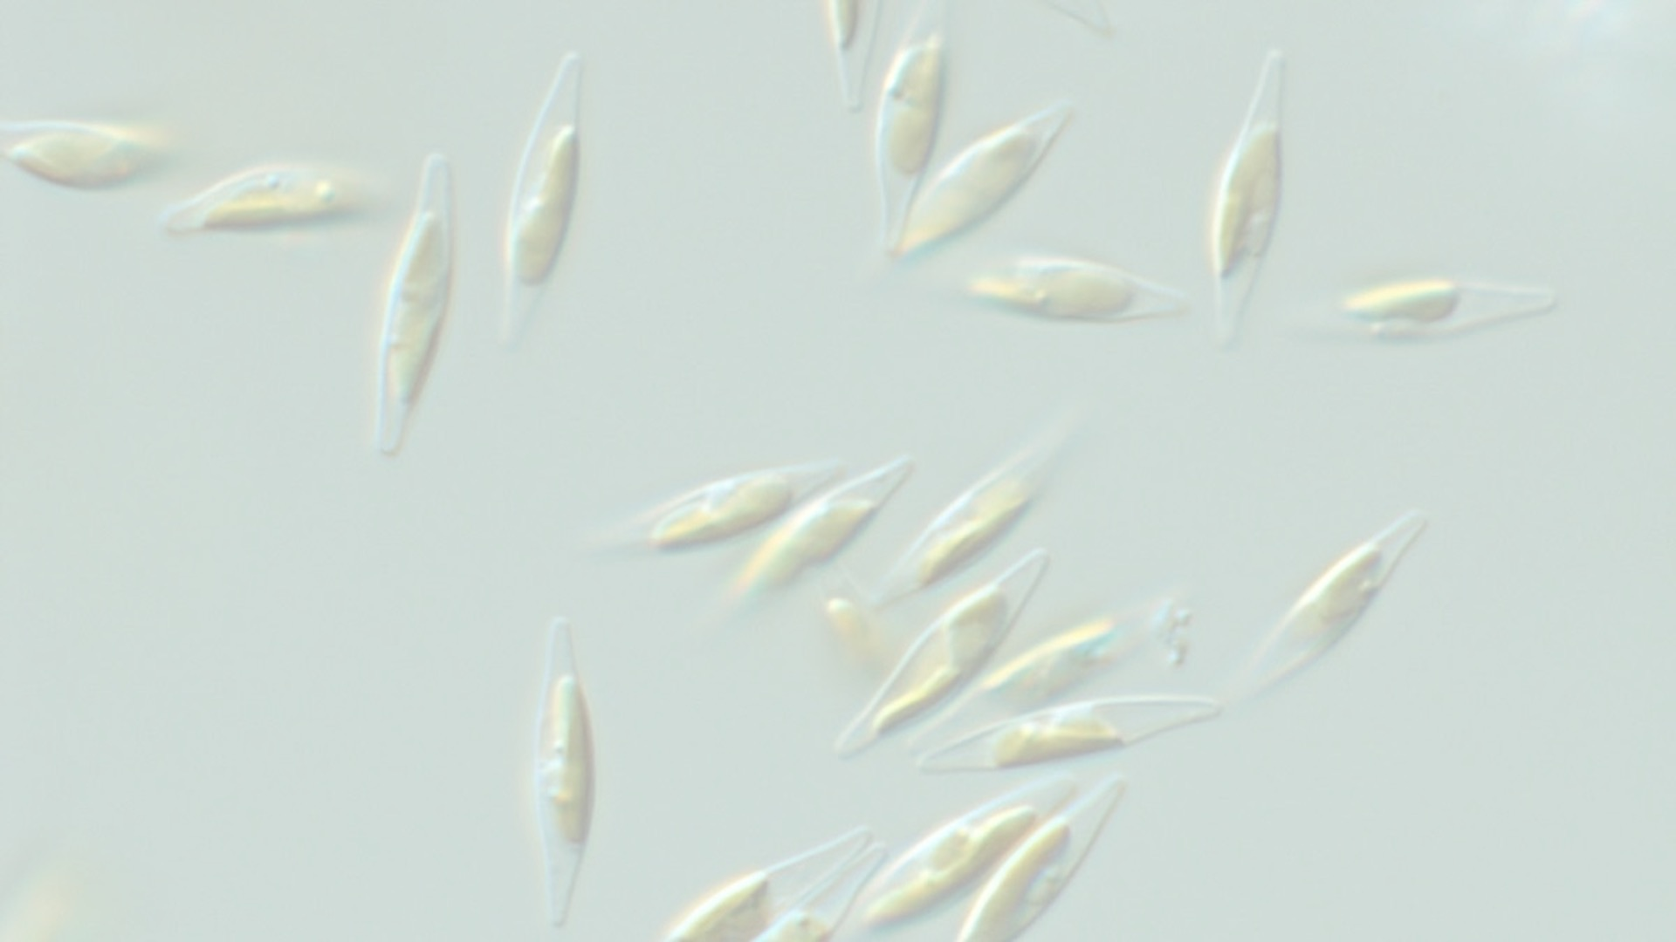
Multi-site group
Notes:
This is a multi-site, multi-disciplinary group assembled by Martin Flately (Suncor)
The group has been meeting weekly to discuss protocols, share results, and trouble-shoot collectively
The flow of materials is approximately linear as shown but feedback loops are not indicated
Design is Sam Slattery/Emily Stuckless in Edgell lab
Construction is Sam/Emily and Arina Shrestha in Karas Lab
Verification is Dan Giguere/Henry Say in Gloor lab for sequencing, and Sam/Emily/Arina for PCR
Protein testing is Sam/Emily
Protein lead candidate is Alexa Galbraith and Steve Reaume at Lambton College
Protein production at scale is Peter Howard/Liann Dsousa at Pond Technologies
Growth optimization is collaboration between Pond and Lambton
Purification and QC is Lee Ann Briere/Victoria Clarke in Core Facility
Test validation is Garth Styba and team at IPOC/Lumivee

Slide 3
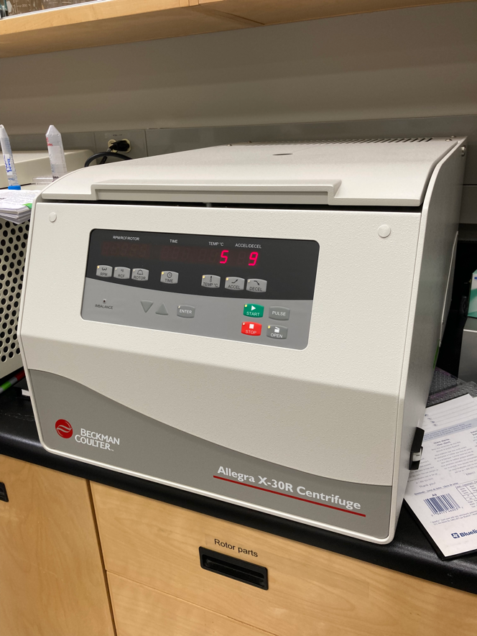
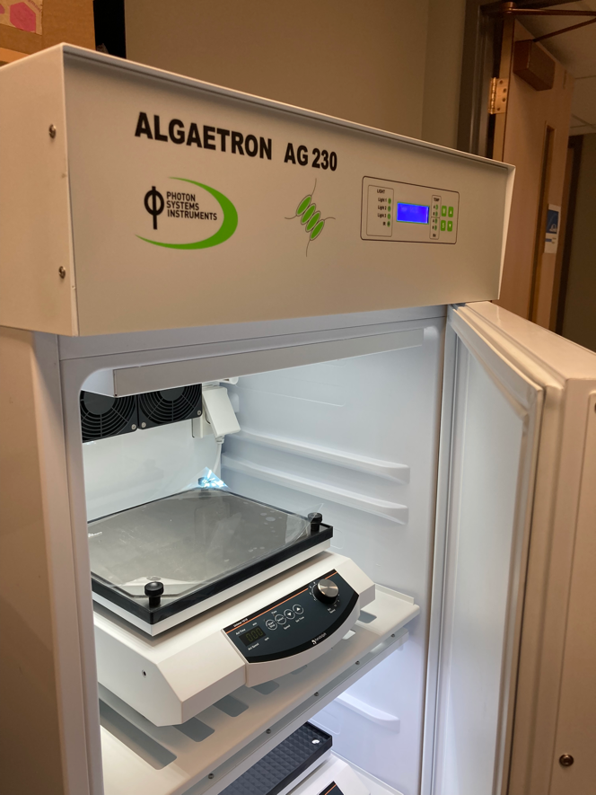
Suncor purchased equipment
Plate centrifuge - plasmid
Illuminated growth chamber
Notes:
The plate centrifuge increase our ability to produce and analyze a large number of colonies and plasmids concurrently
The growth chamber allows small scale local algae growth under optimum conditions

Slide 4
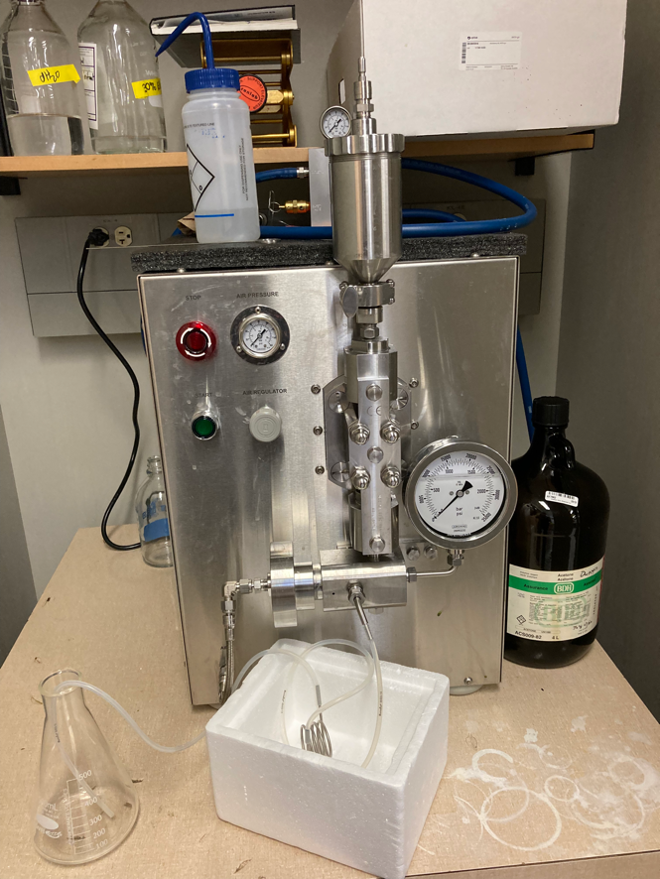
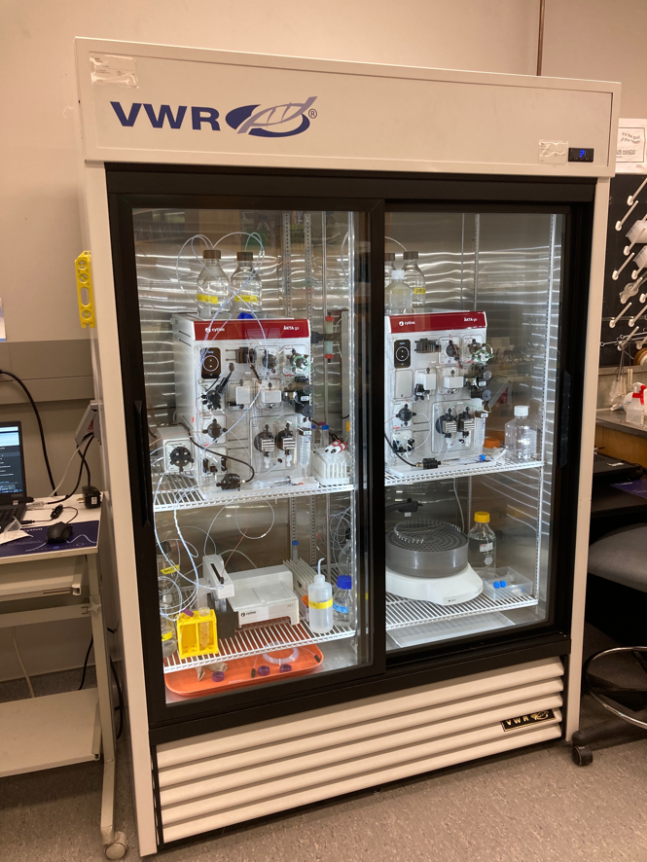
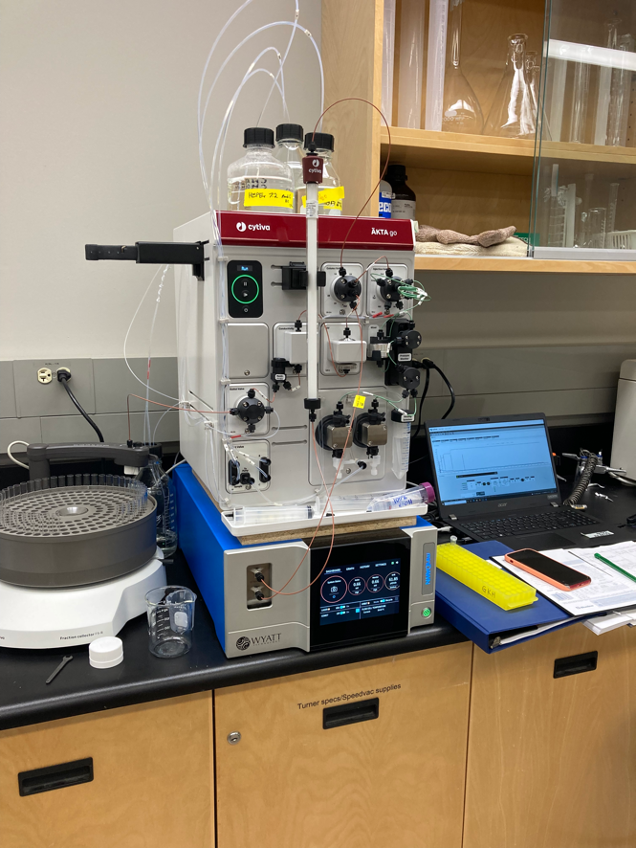
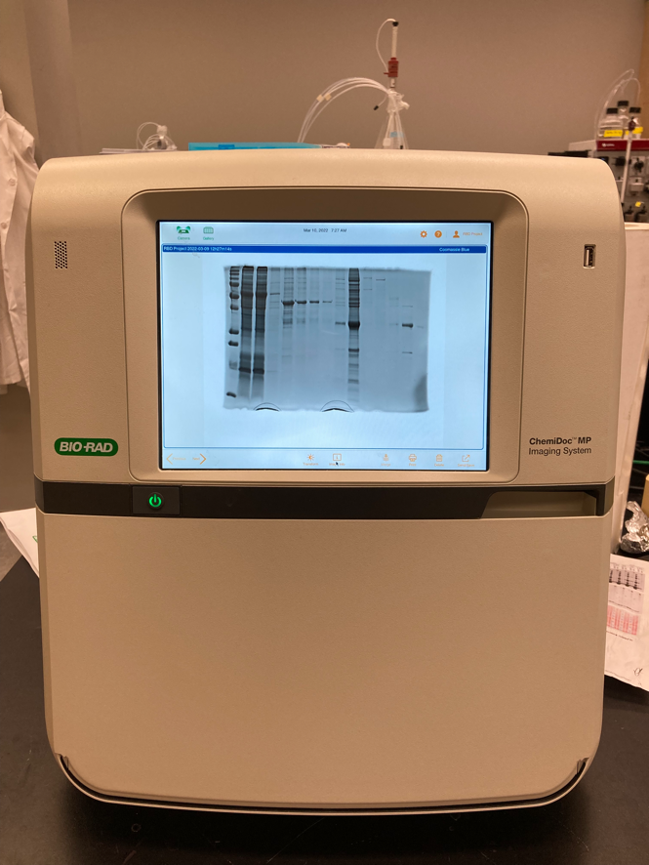
Suncor purchased equipment
Cell Disruptor
Dual AKTA purification system
AKTA/MALS QC system
Documentation system
Notes:
Cell Disruptor is used to break open cells from Lambton and Pond growths
Dual AKTA is used to purify the protein
AKTA/MALS will be used to QC final production protein preps
Documentation system is used to capture images of gels used for QC and protein tracking

Slide 5
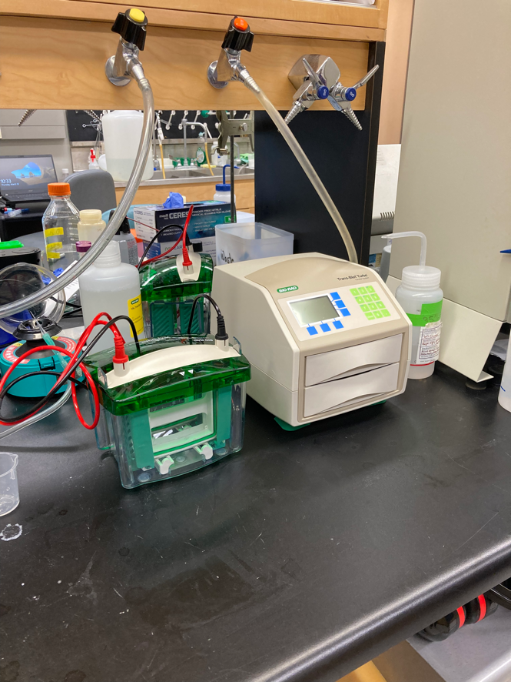
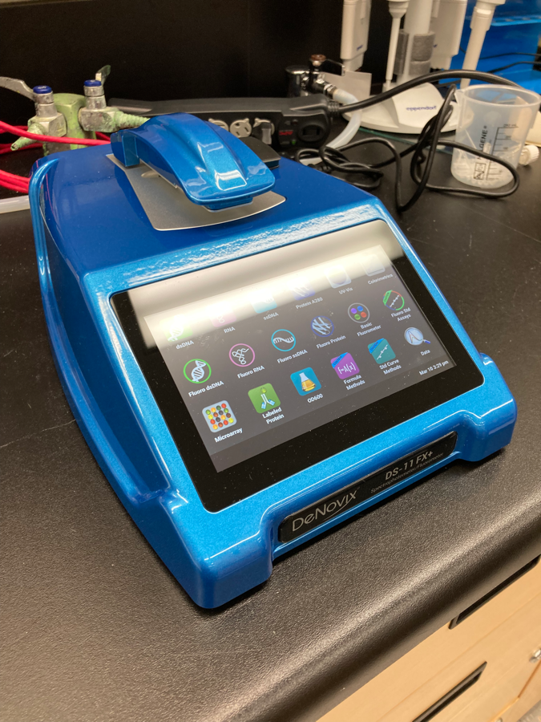
Suncor purchased equipment
Gel and Blot QC
NanoDrop QC/Quantification
Notes:
Gel and blos system is used to produce for protein tracking and QC
Nanodrop is used to quantitate final product in a non-destructive way

Slide 6
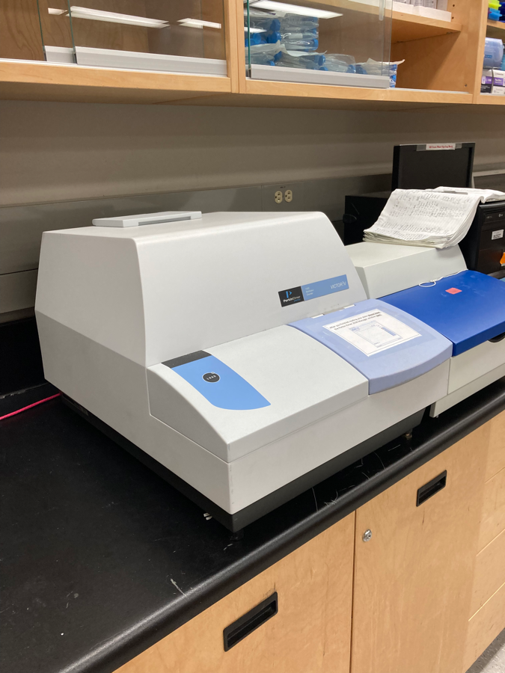
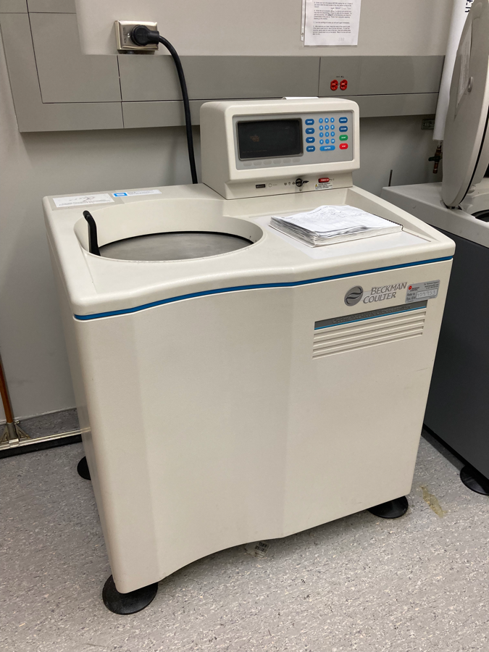
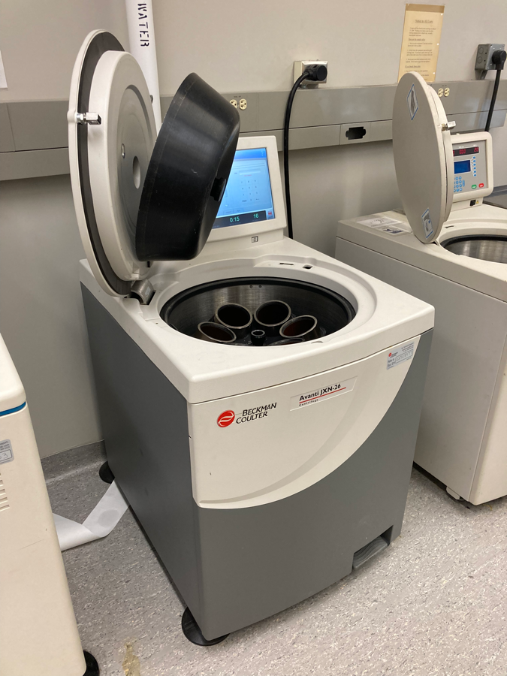
Leveraged equipment
Plate reader
Ultracentrifuge x2
Low speed centrifuge
Notes:
This major equipment is essential to the project and is existing
The plate reader is used for protein quantification (ELISA) and for analysis of production in small scale cultures
The Ultracentrifuge and rotors are used to remove contaminants in the protein lysates prior to loading on the AKTA
The low speed centrifuge is used to concentrate cells prior to lysis

Slide 7
Latest results
Notes:
The output of the final step from the AKTA system run by Lee and Victoria
Each trace is the fluorescence signal and corresponds to the amount of protein at each stage. RBD runs at 16-17 ml in this system and is labelled.
Four recent preps are shown and the most recent Pond growth suggests the largest amount of RBD yet (High purple peak at 17)
Other preps have either had no protein (Pond bad) or intermediate amounts of protein (Lambton good or Lambton bad)
We now know what makes a good and a bad growth for protein purification and are standardizing these conditions

Slide 8
Latest results
Notes:
This is a gel of the sample as it progresses through the AKTA system. We are trying to achieve a sequential separation of the RBD protein from the complex protein mixture
Second from the left is the impure loading mixture of all soluble proteins from 5 liters of algae growth. It is a hot mess of everything and the RBD is not visible
The Ni Elute shows a minor band of RBD (arrow)
The IEX Elute and SEC Load shows RBD as the major band
SEC 17 shows RBD as about 80% of the total protein in the mixture (ie. Success!)

